Slide 1
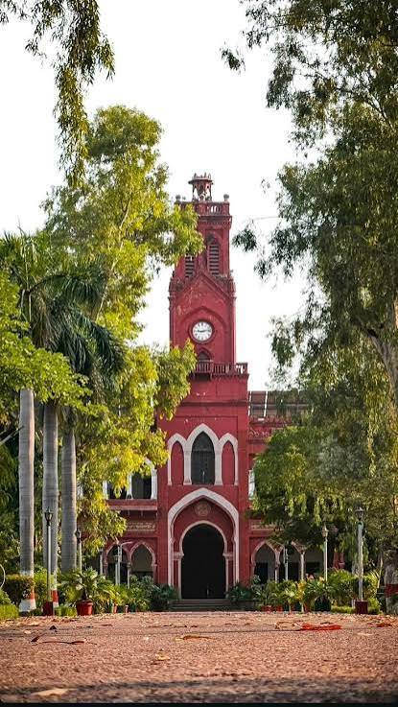

DEPARTMENT OF COMPUTER SCIENCE
ALIGARH MUSLIM UNIVERSITY
IT FEST
2026
Where Ideas Compile Into Innovation
Date:
24th – 26th September 2026
Venue:
Kennedy Auditorium, AMU Campus
Highlights:
Hackathon · Robotics · Tech Talks · Coding Contest
ALL DEPARTMENT STUDENTS INVITED!
Register at: itfest.amu.ac.in

